Slide 1
Design and Implementation of a Mobile-Based Archival and Retrieval of Missing Objects Application using Image Matching
System Modeling and Design

Slide 2
Introduction

Slide 3
System Requirements
Functional Requirements
-User account creation/authentication
-Reporting missing objects
-Reporting found objects
-Image matching

Slide 4
Non-Functional Requirements
-Performance optimization
-Easy usability
Localisation

Slide 5
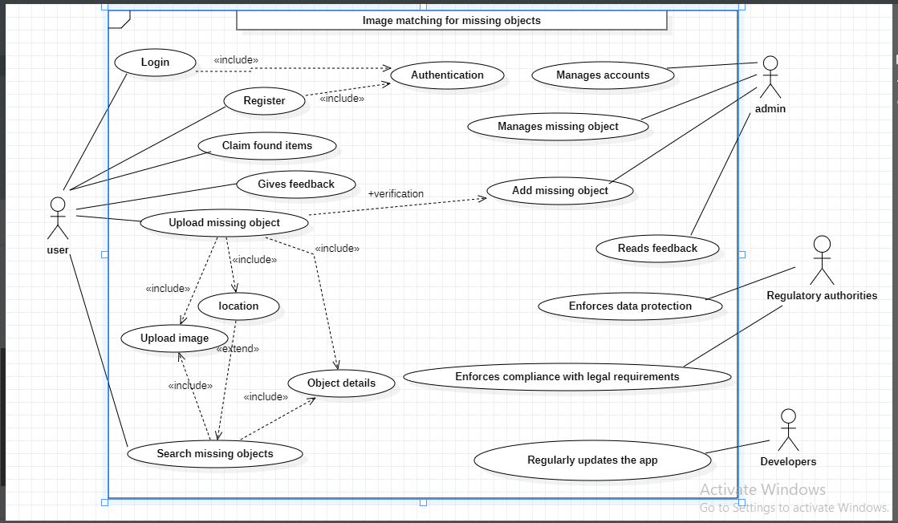
System Modeling
Use Case Diagram

Slide 6
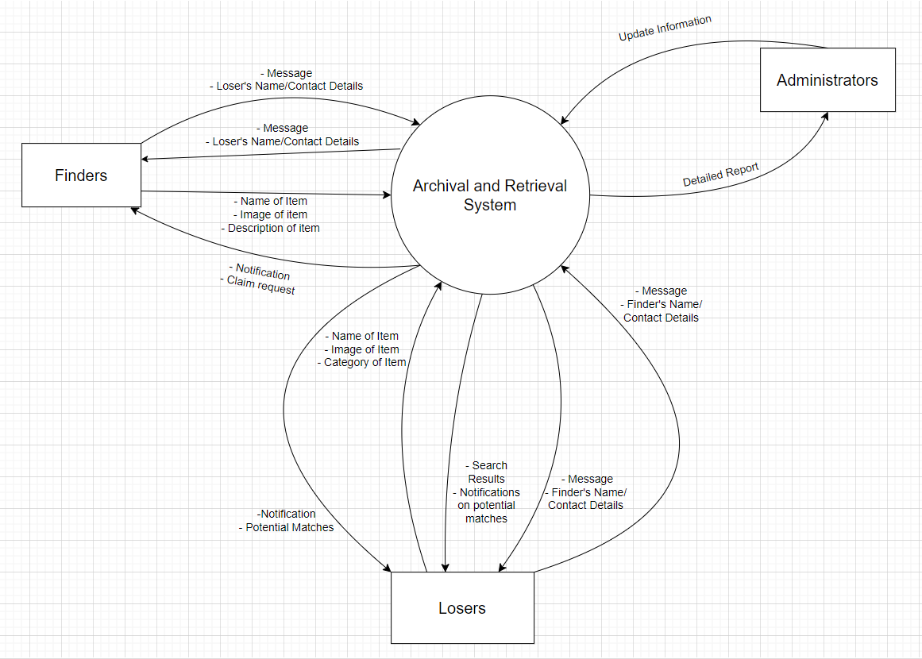
Context Diagram

Slide 7
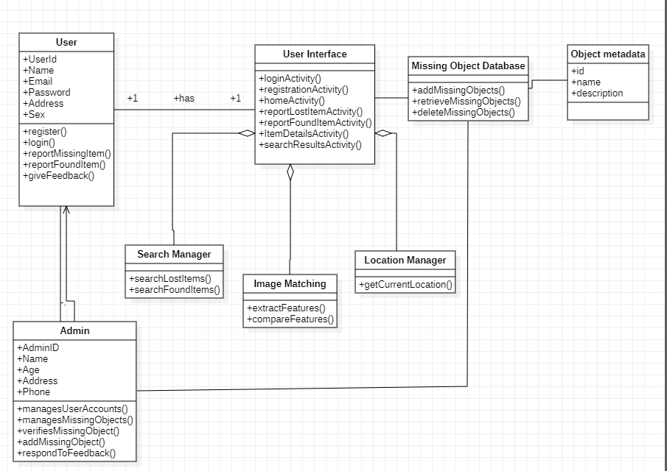
Class Diagram

Slide 8
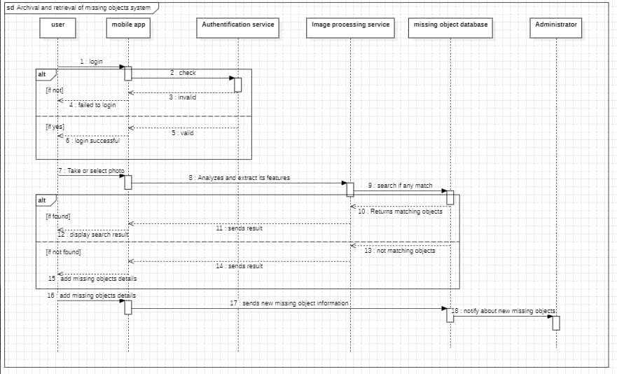
Sequence Diagram

Slide 9
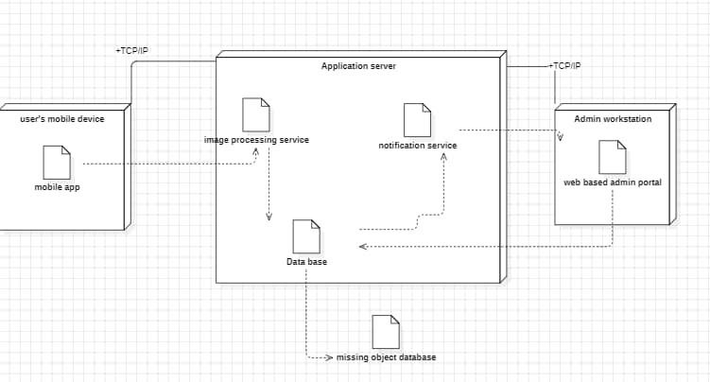
Deployment Diagram

Slide 10
Testing
-System testing
-User acceptance testing
-Performance testing
-Functionality testing
-Unit testing

Slide 11
Thank you for listening

